Slide 1
House sales analysis dashboard
BY –
Swarn Prabha
PRN - 23030141069

Slide 2
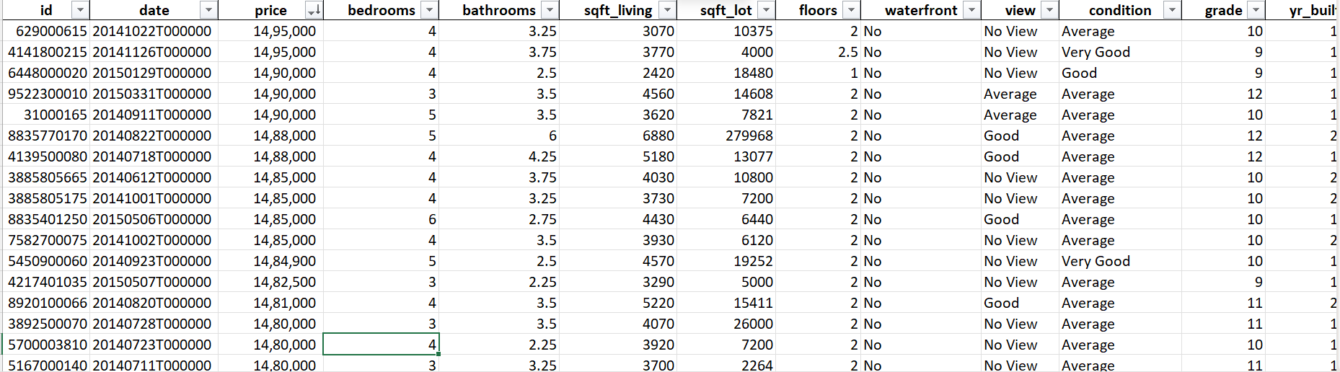
introduction
Overview of the dashboard analyzing house sales data.
Focus on factors influencing house prices: view quality, house condition, year built, and number of bathrooms.
Purpose: To help stakeholders understand key trends and insights from the dataset.

Slide 3
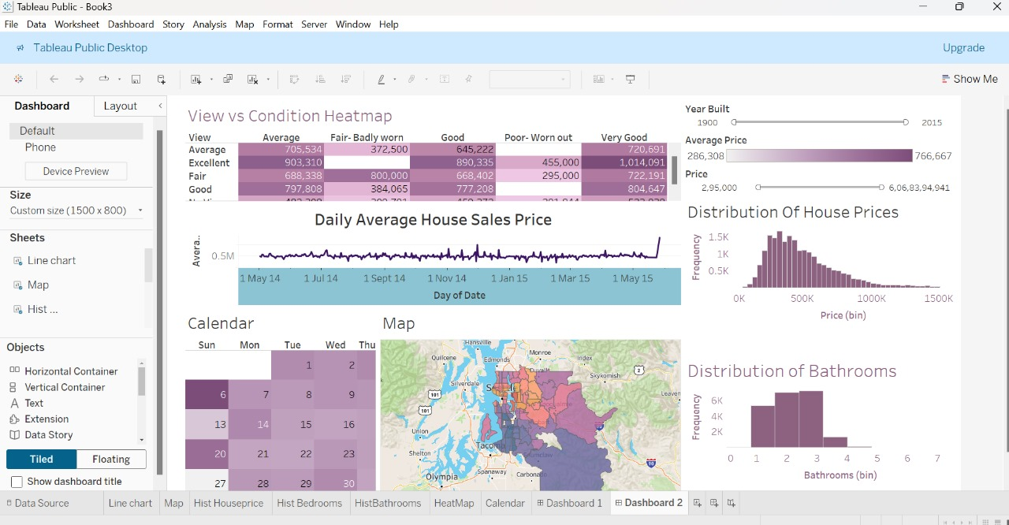
DASHBOARD

Slide 4
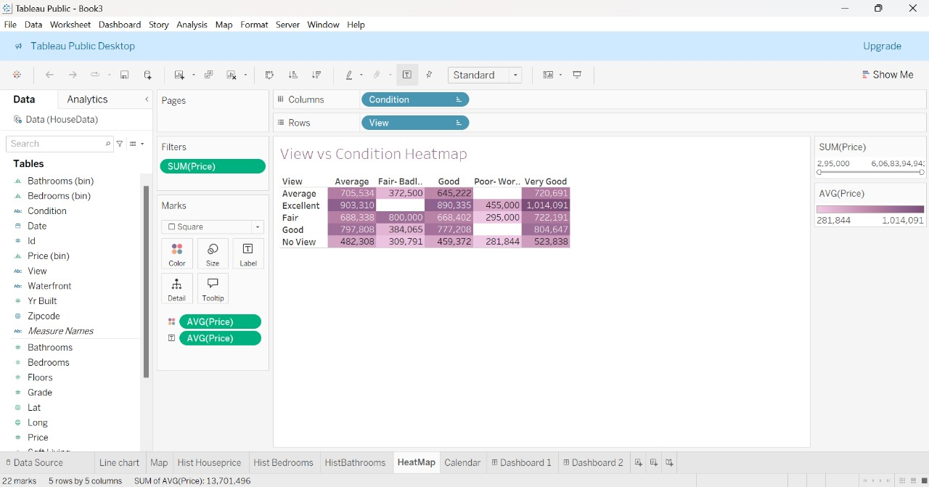
View vs. Condition Heatmap
View vs. Condition Heatmap
Displays the correlation between view quality and house condition.
Insight: Houses with an "Excellent" view and in "Very Good" condition have the highest average sale price.

Slide 5
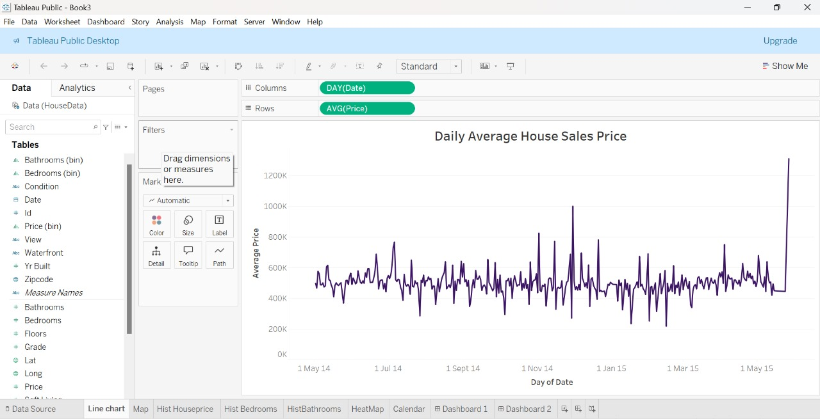
Daily Average House Sales Price
Line chart showing daily trends in average house sale prices.
Insight: Prices are stable with a noticeable spike toward the end, potentially due to seasonal factors.

Slide 6
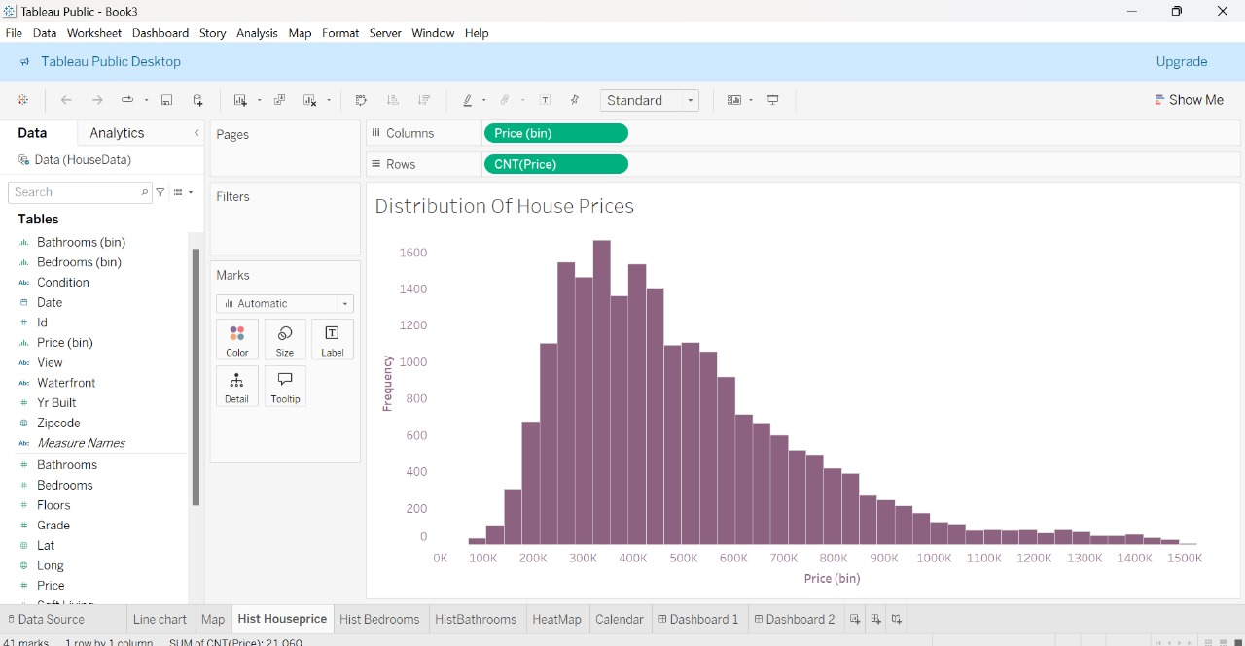
Distribution of House Prices
Histogram representing the distribution of house prices.
Insight: Most prices fall between $200,000 and $600,000, suggesting affordability in the region.

Slide 7
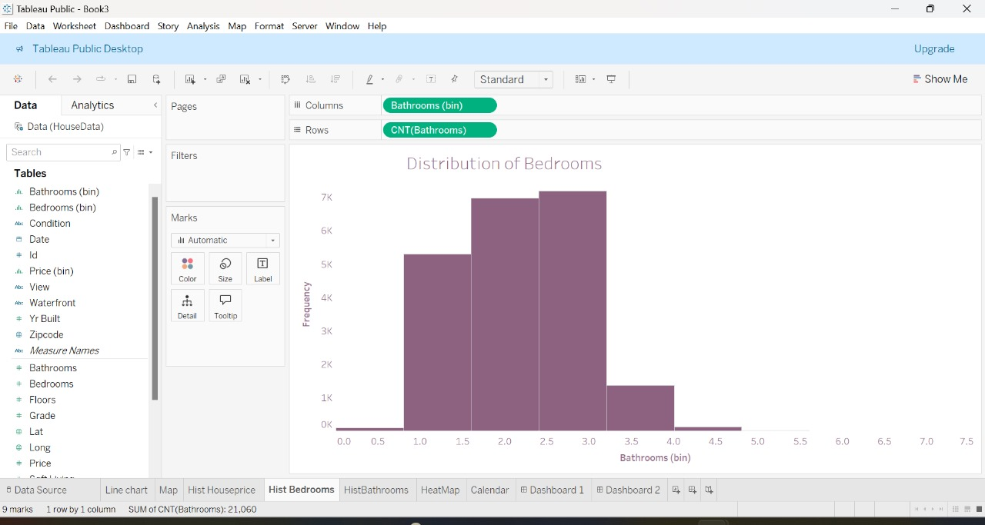
Distribution of Bathrooms
Bar chart showing the distribution of houses based on the number of bathrooms.
Insight: The majority of houses have 2 or 3 bathrooms, typical for family homes.

Slide 8
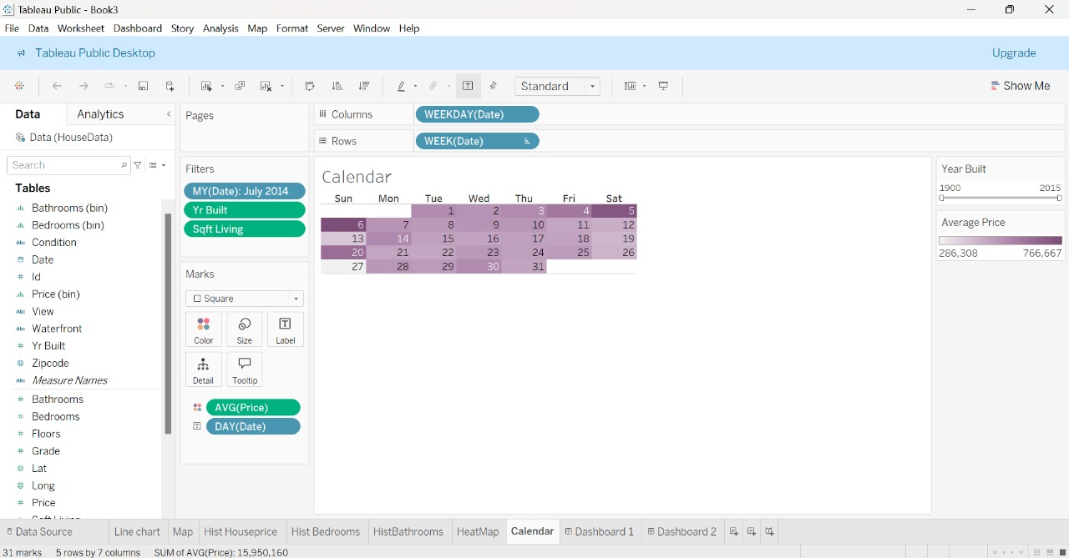
Calendar Heatmap
Displays the number of house sales per day.
Insight: Sales are evenly distributed, with some peak days indicating higher transaction volumes.

Slide 9
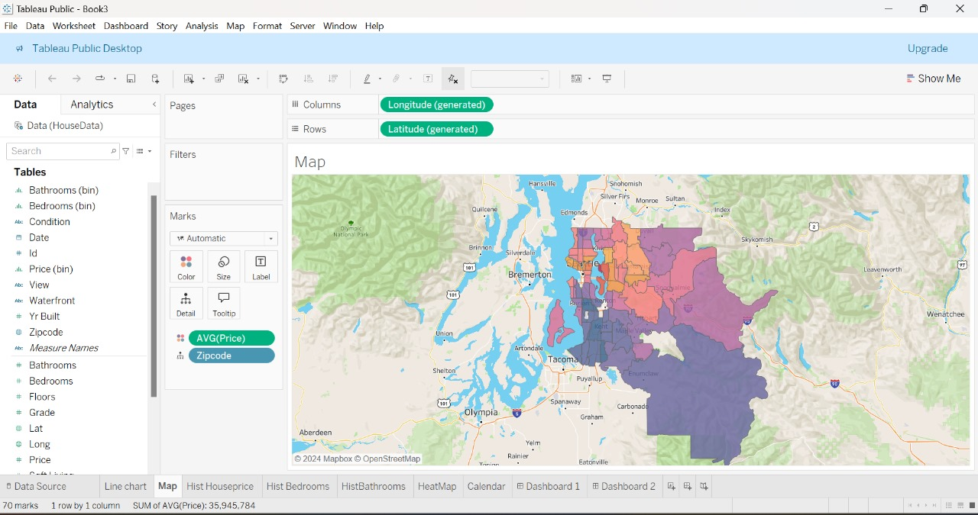
Geographical Map
Map showing the distribution of house sales across Washington State.
Insight: Sales are concentrated in major cities like Seattle, Tacoma, and Olympia, reflecting urban demand.

Slide 10
Conclusion
The dashboard provides valuable insights into the factors influencing house prices.
Highlights include the importance of view quality, house condition, and construction year.
Useful tool for real estate professionals, investors, and policymakers to make informed decisions.

Slide 11


